Slide 1
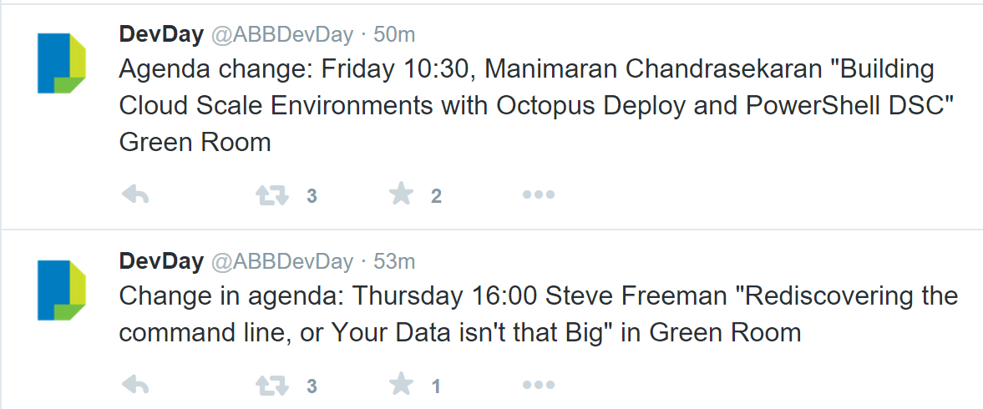

Slide 2
Roslyn Code Gems K. Scott Allen

Slide 3
READ CODE

Slide 4
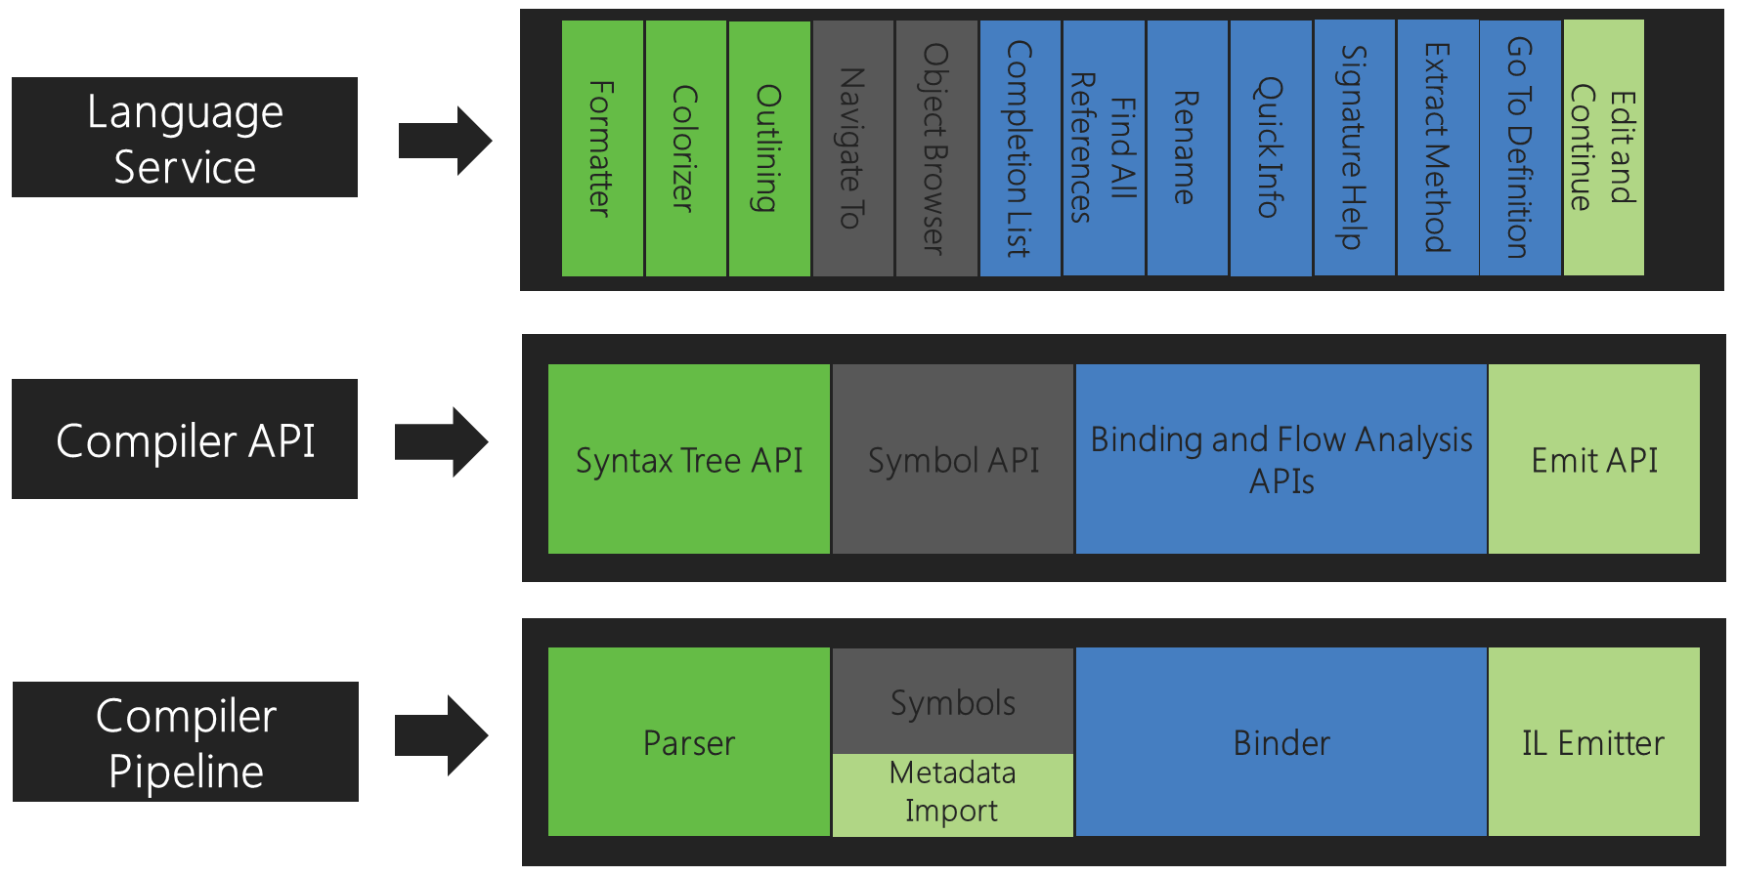

Slide 5
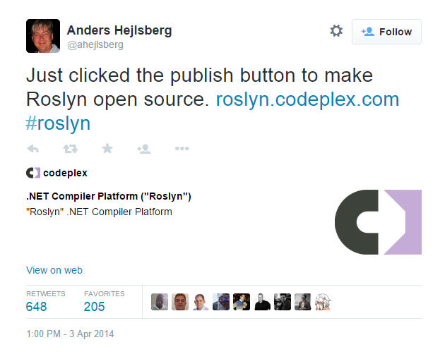

Slide 6
The decision to make Roslyn open source
did not come out of the blue.
In our original architecture discussions in 2009,
we dreamt of open sourcing our language compilers.
-- Kasey Uhlenhuth, Program Manager, Managed Languages Team

Slide 7
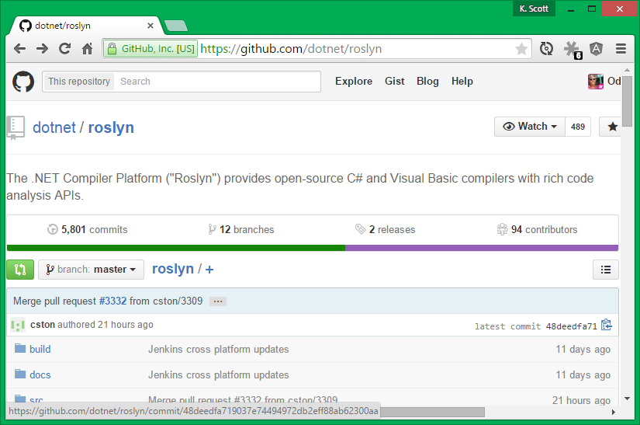

Slide 8
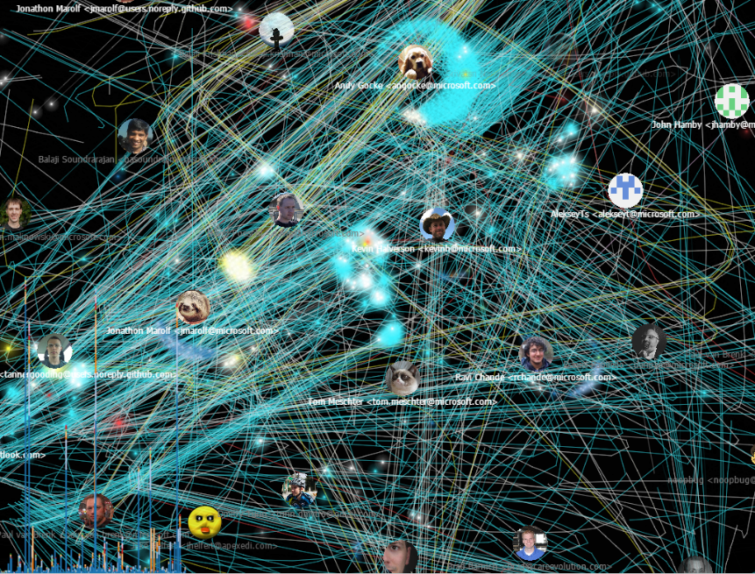
Stats
> 130 Projects
> 3.5 million lines of code

Slide 9
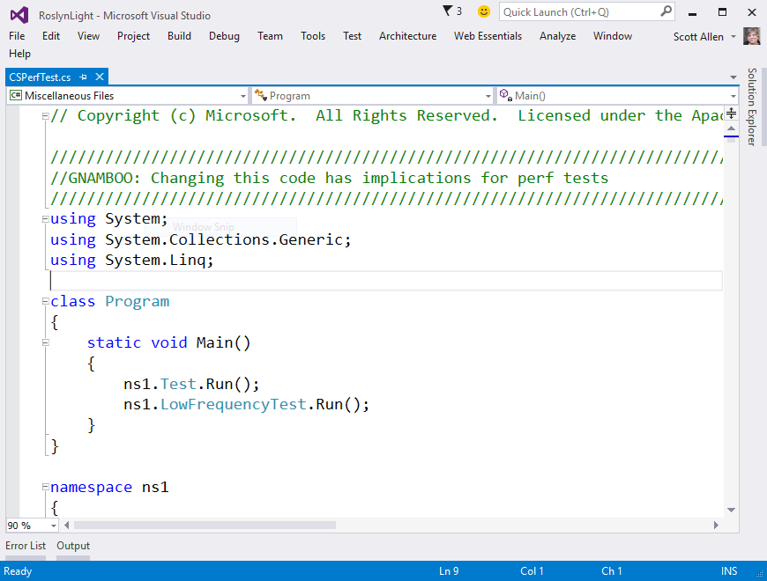
Performance

Slide 10
?
What is Roslyn obsessed about?
CPU usage
Memory allocations
Disk IO
Moving all your code to Azure

Slide 11
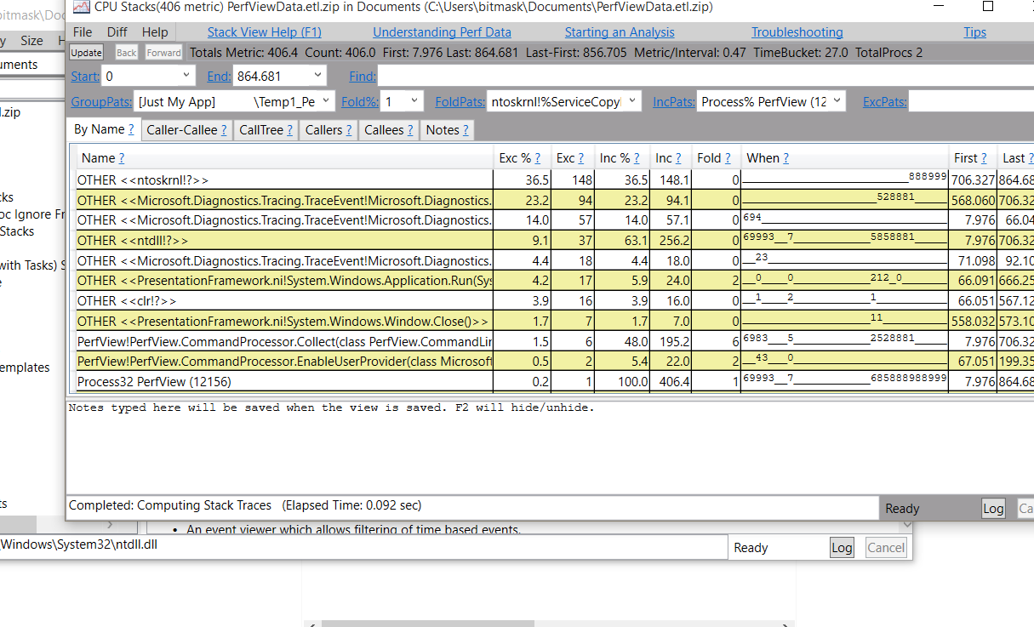
PerfView

Slide 12
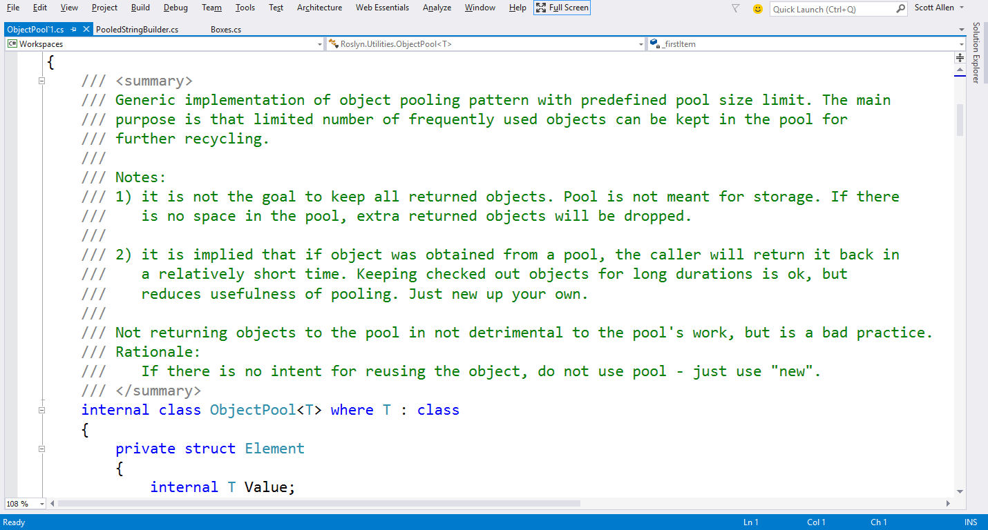
Pooling

Slide 13
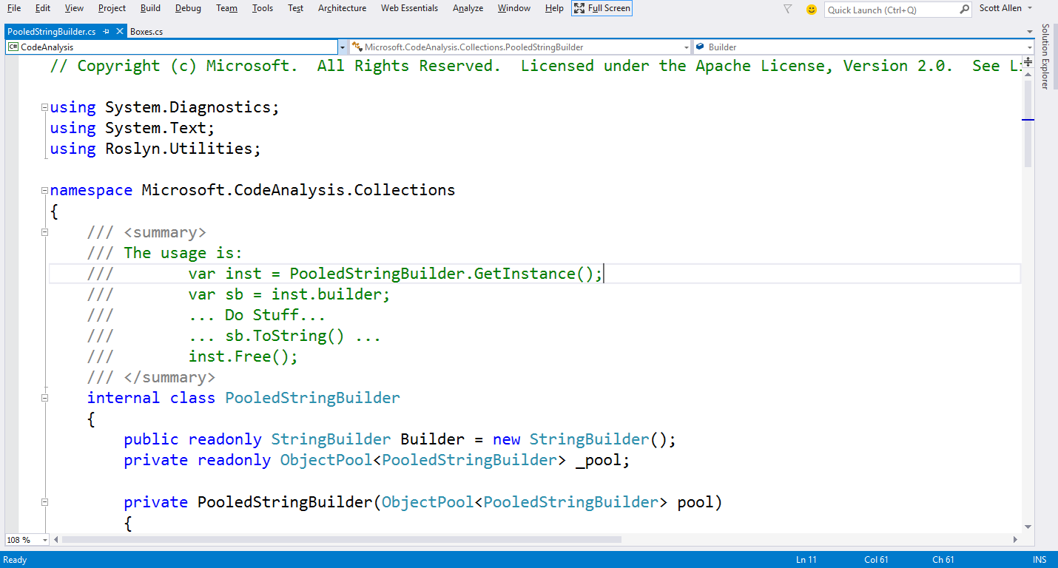
Pooled String Builder

Slide 14
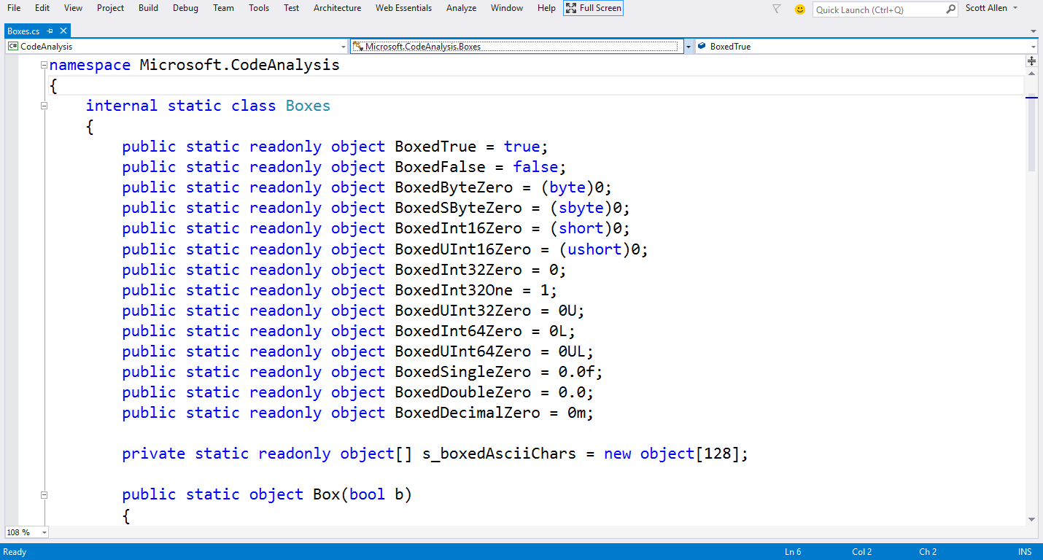
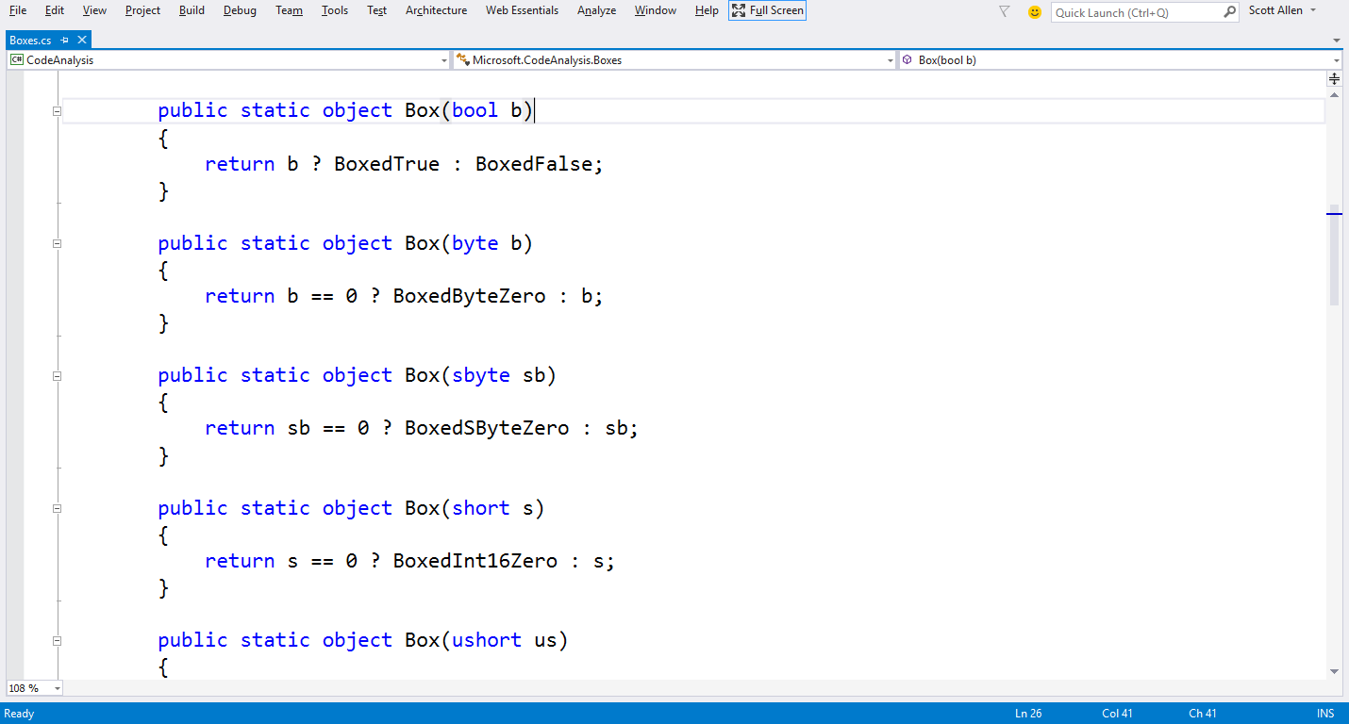
Boxing

Slide 15
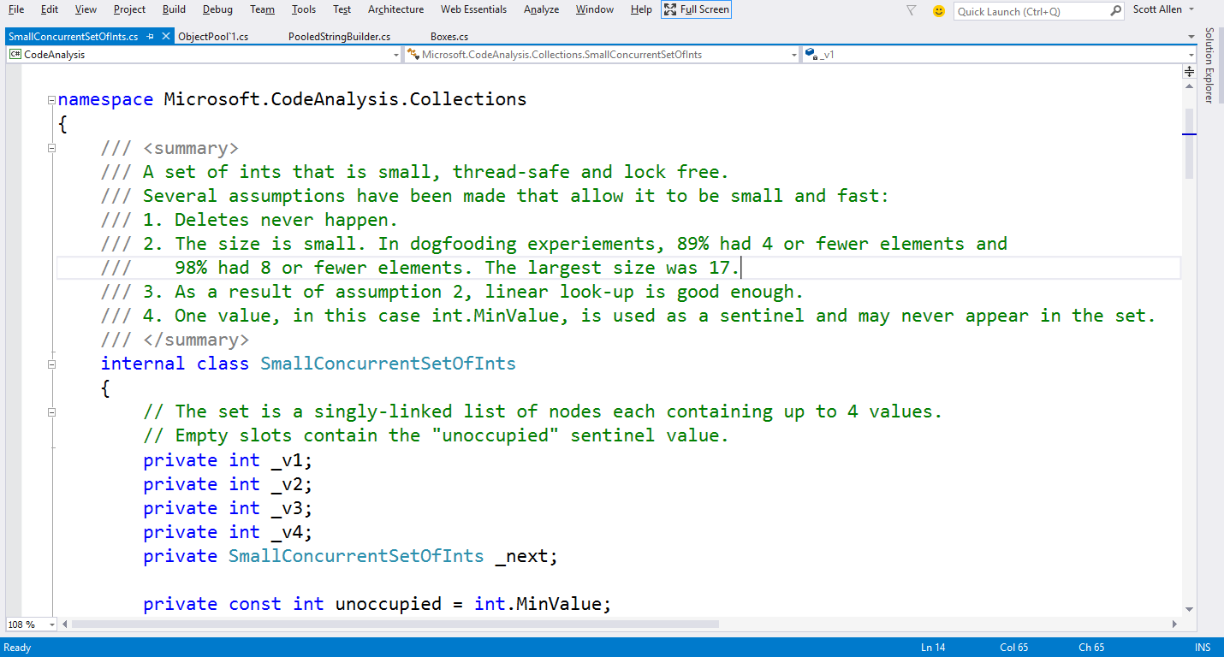
Small Collections (Int)

Slide 16
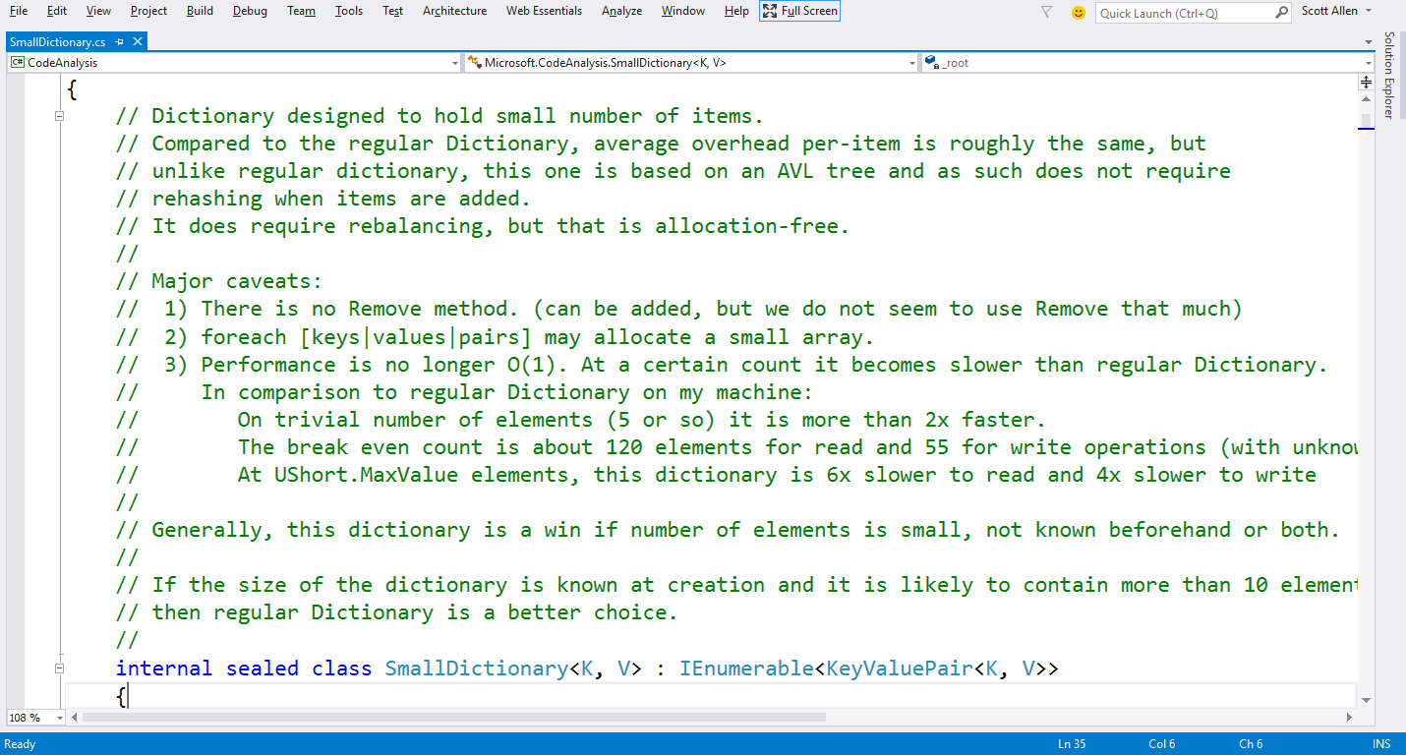
Small Dictionary

Slide 17
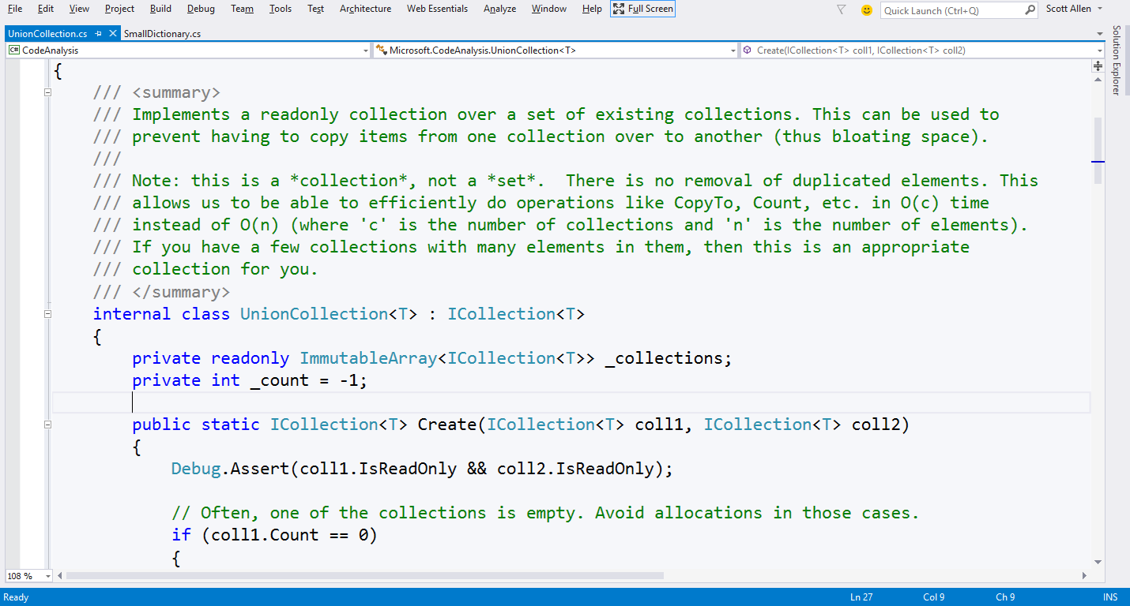
UnionCollection

Slide 18
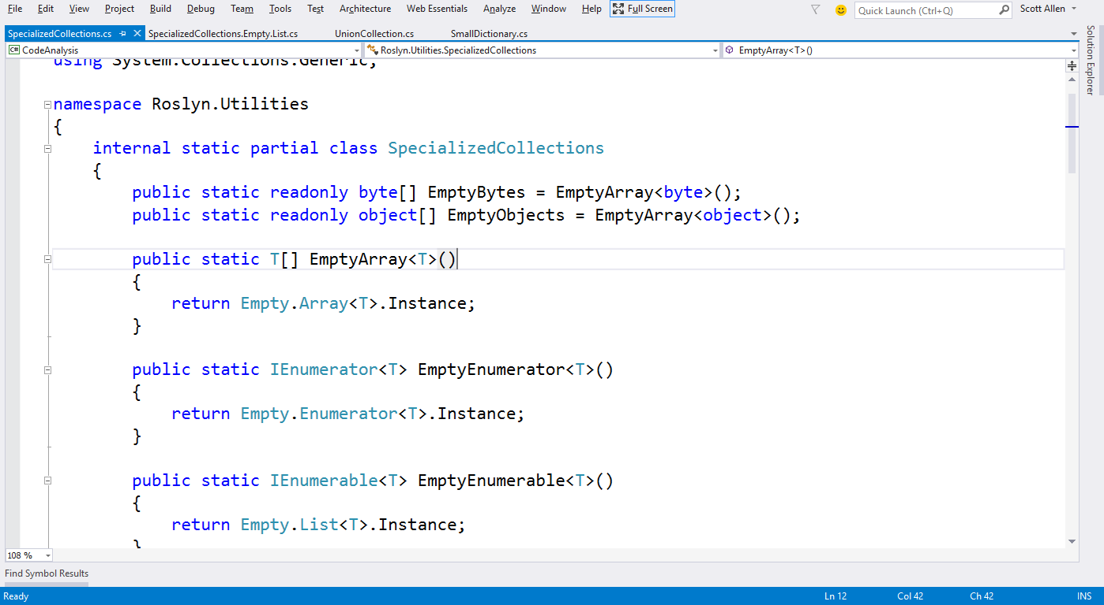
Empty Collections

Slide 19
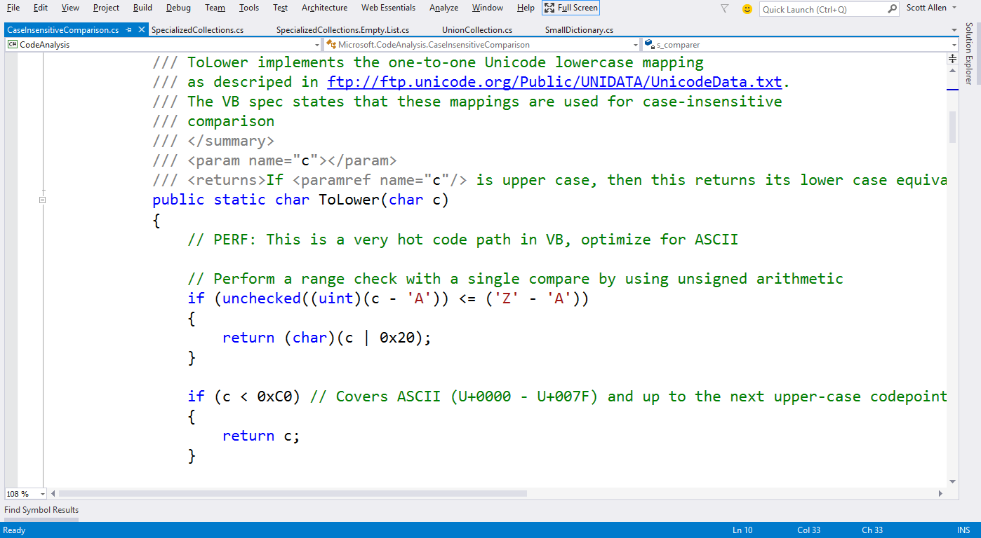
CaseInsensitiveComparison :: ToLower

Slide 20
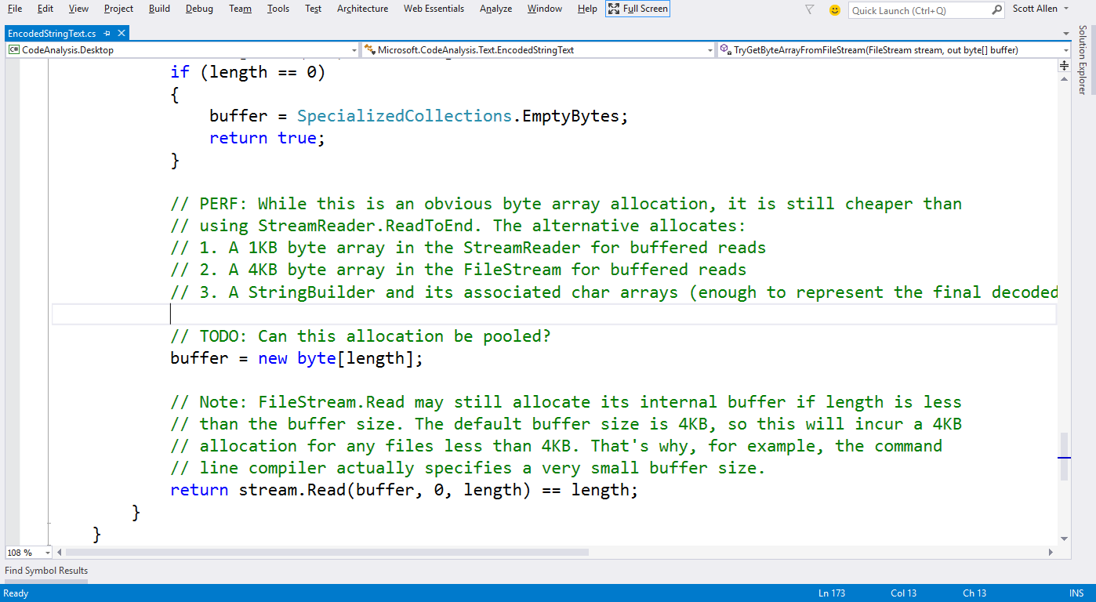
EncodedStringText :: TryGetByteArrayFromFileStream

Slide 21
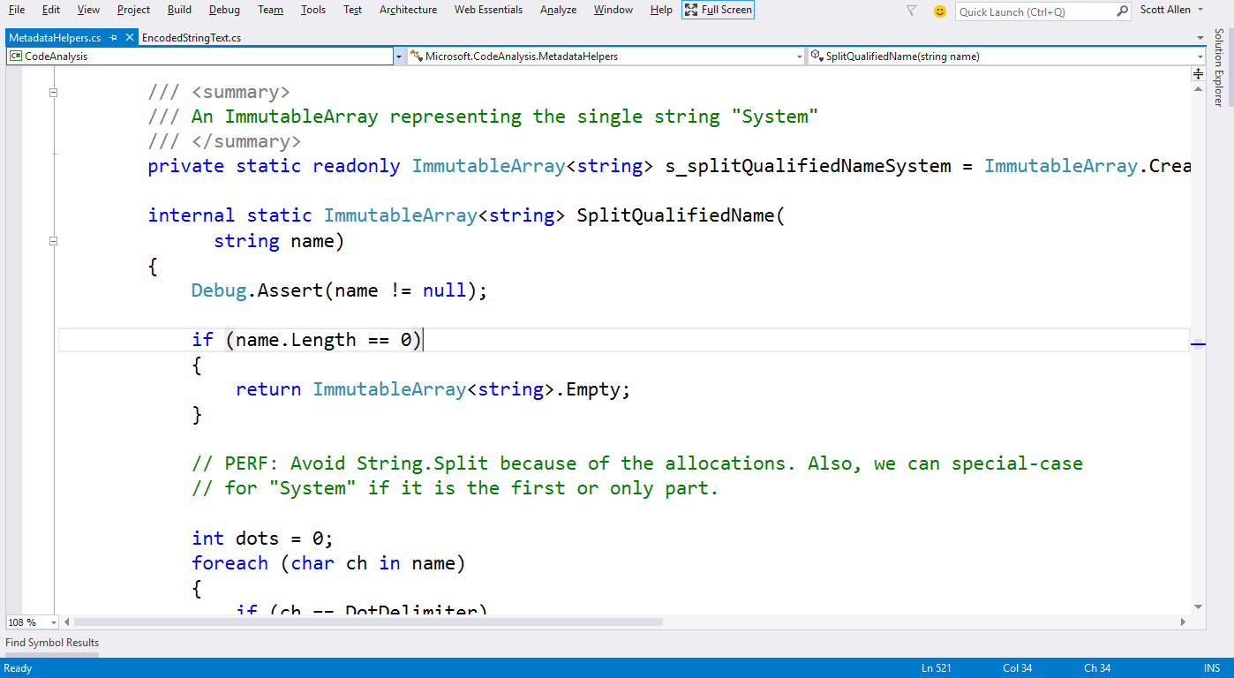
MetadataHelper :: SplitNamespaces

Slide 22
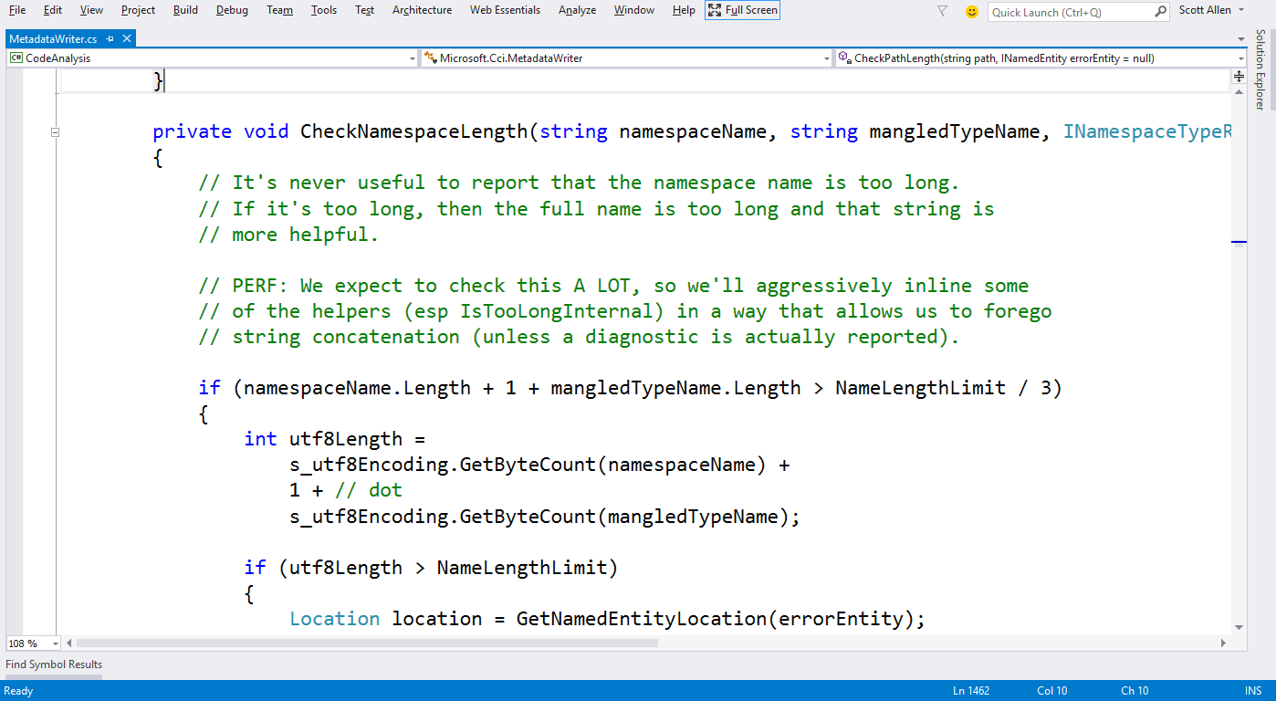
MetaDataWriter : CheckNamespaceLength

Slide 23
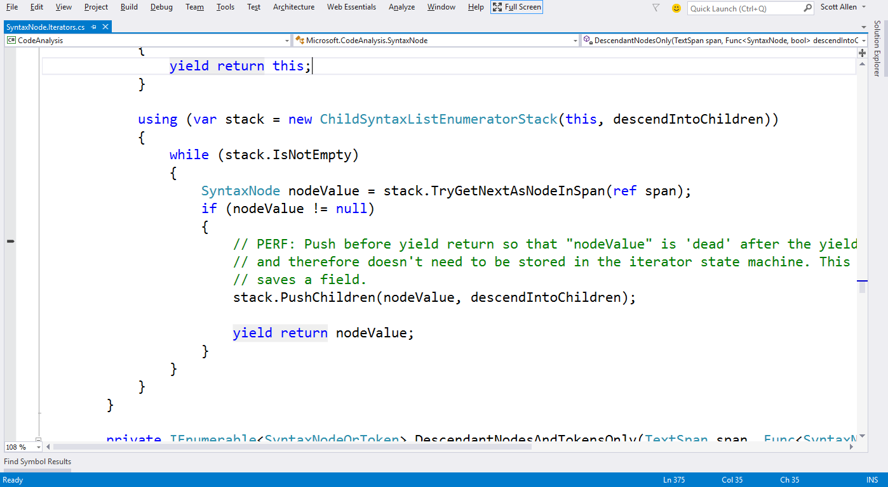
SyntaxNode.Iterator

Slide 24
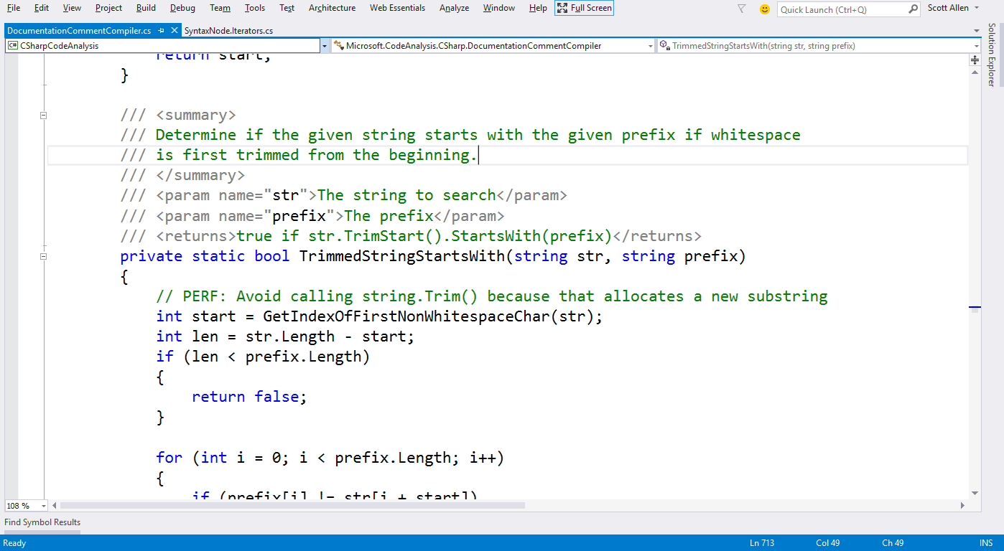
DocumentCommentCompiler

Slide 25
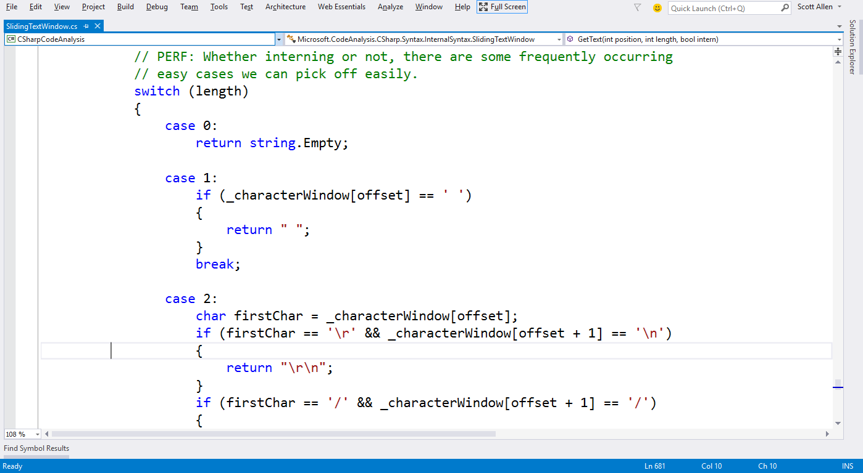
SlidingTextWindow :: GetText

Slide 26
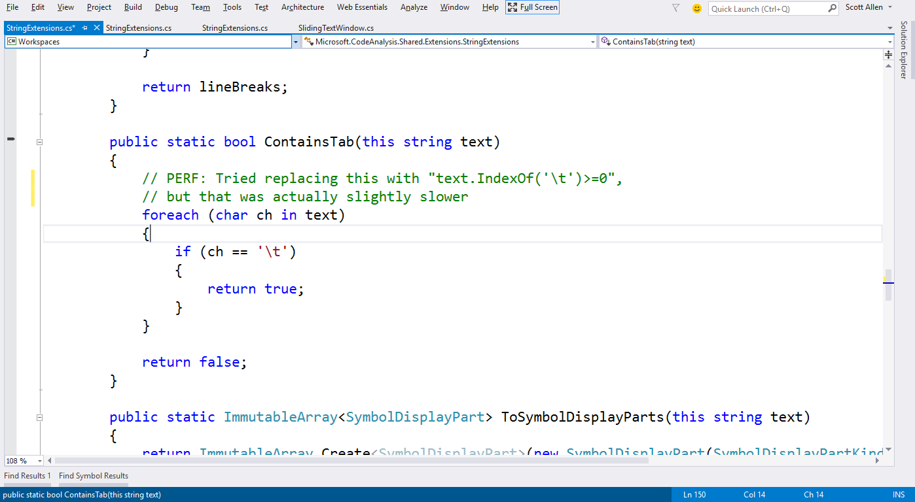
StringExtensions :: ContainsTab

Slide 27
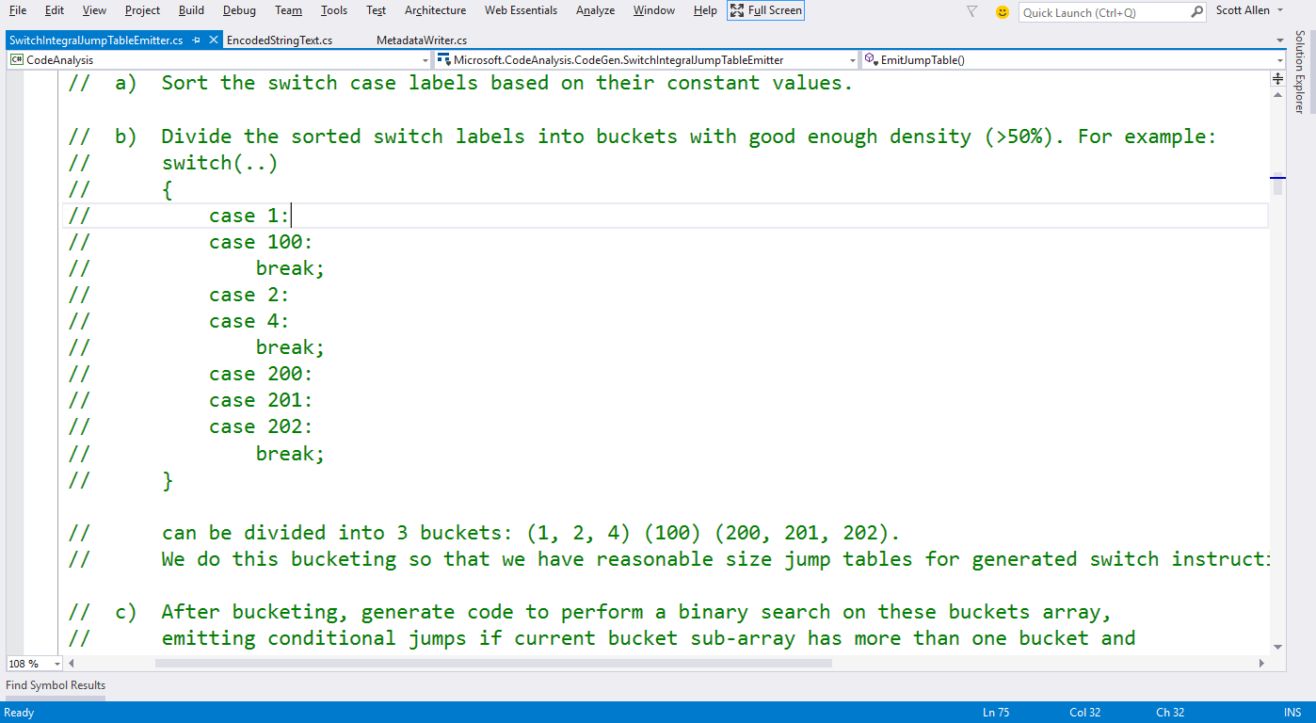
SwitchIntegralJumpTableEmitter

Slide 28
Comments

Slide 29
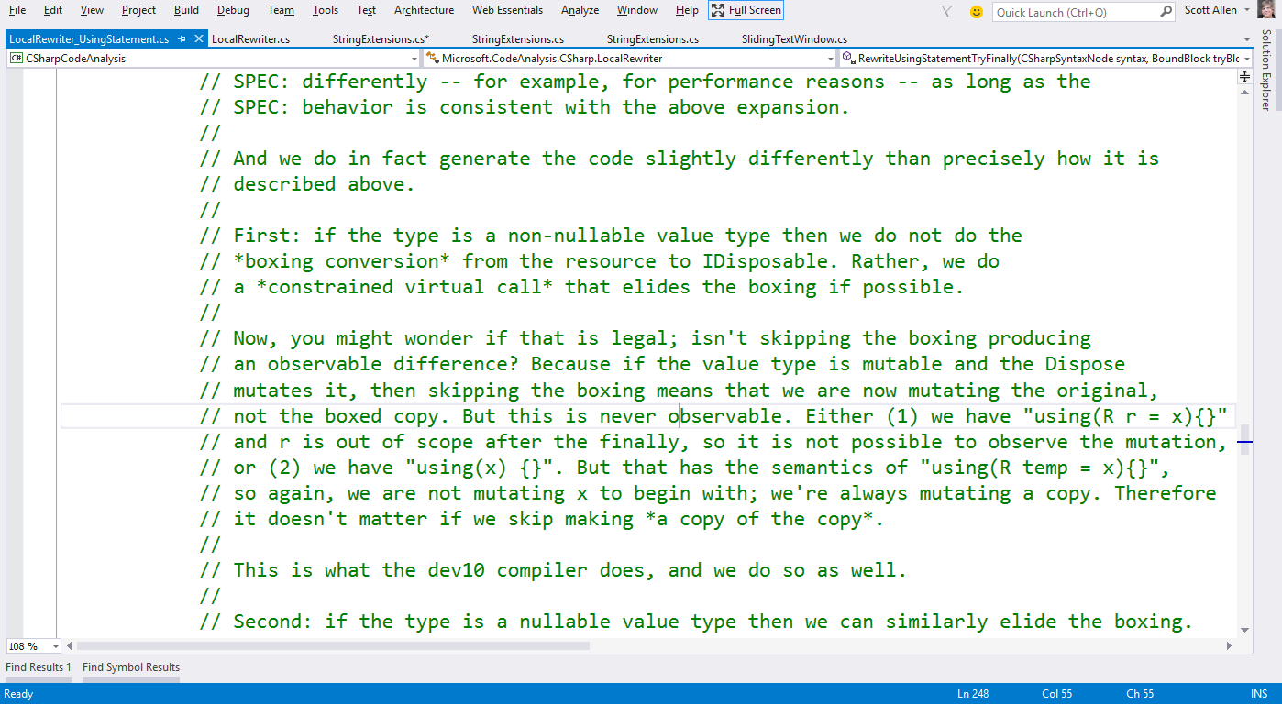
LocalRewriter_UsingStatement

Slide 30
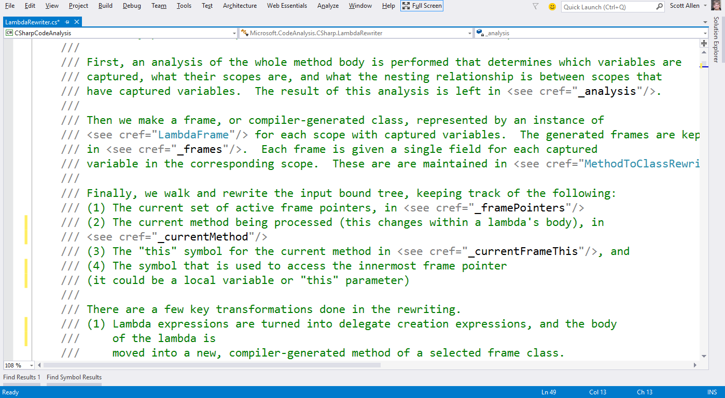
Lambda Rewriter

Slide 31
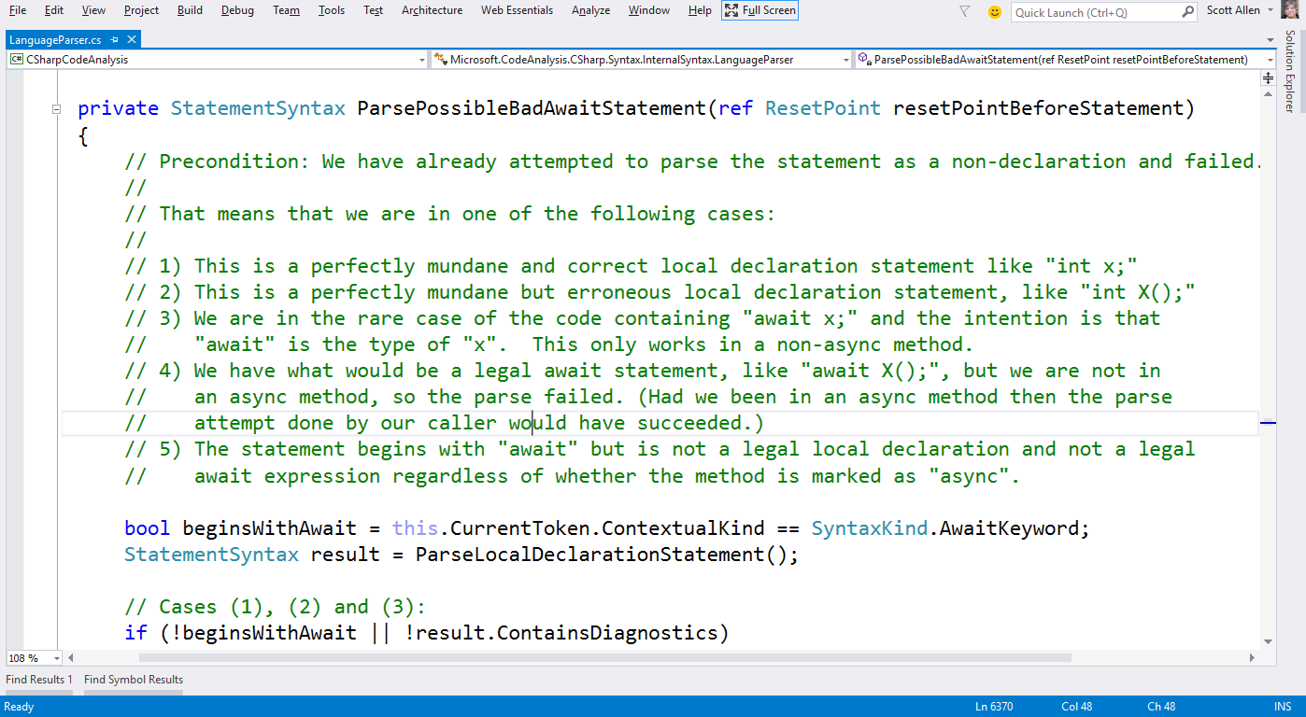
LanguageParser

Slide 32
Useful

Slide 33
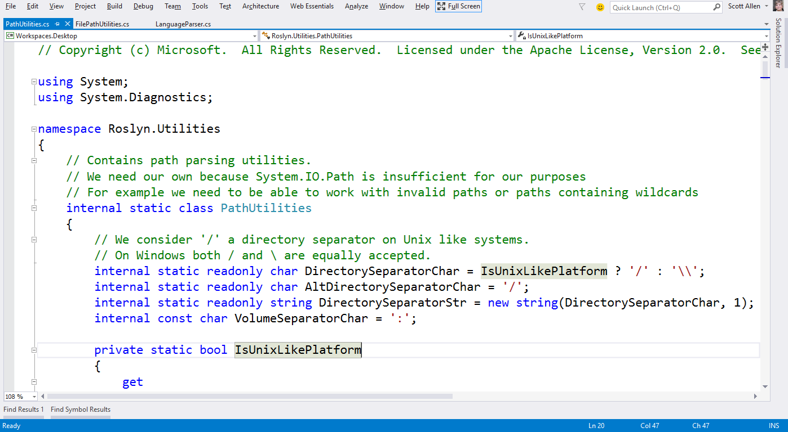
Path Utilities

Slide 34
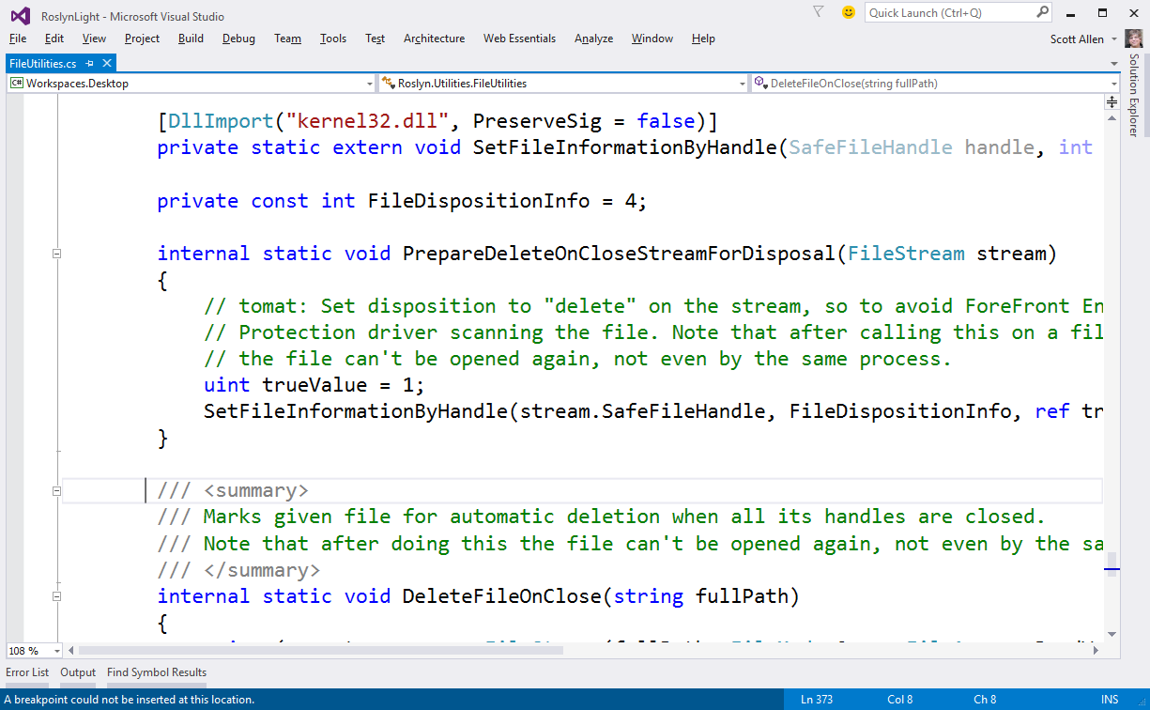
File Utilities

Slide 35
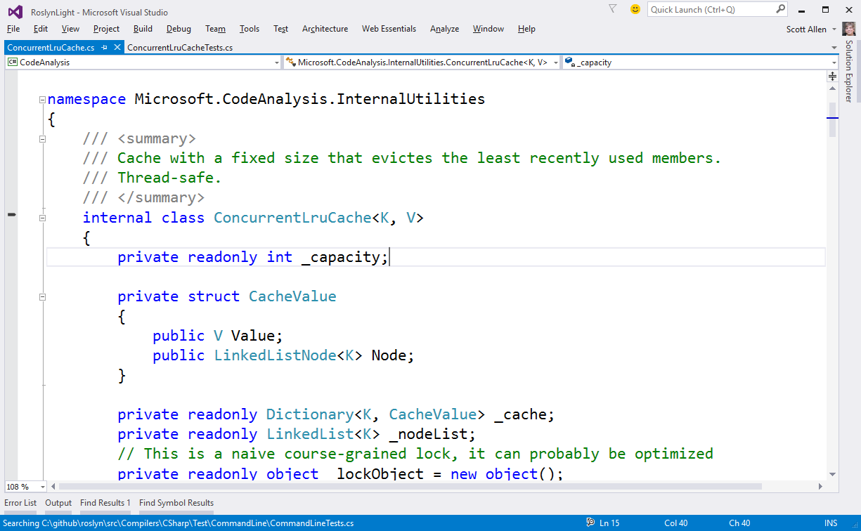
ConcurrentLruCache

Slide 36
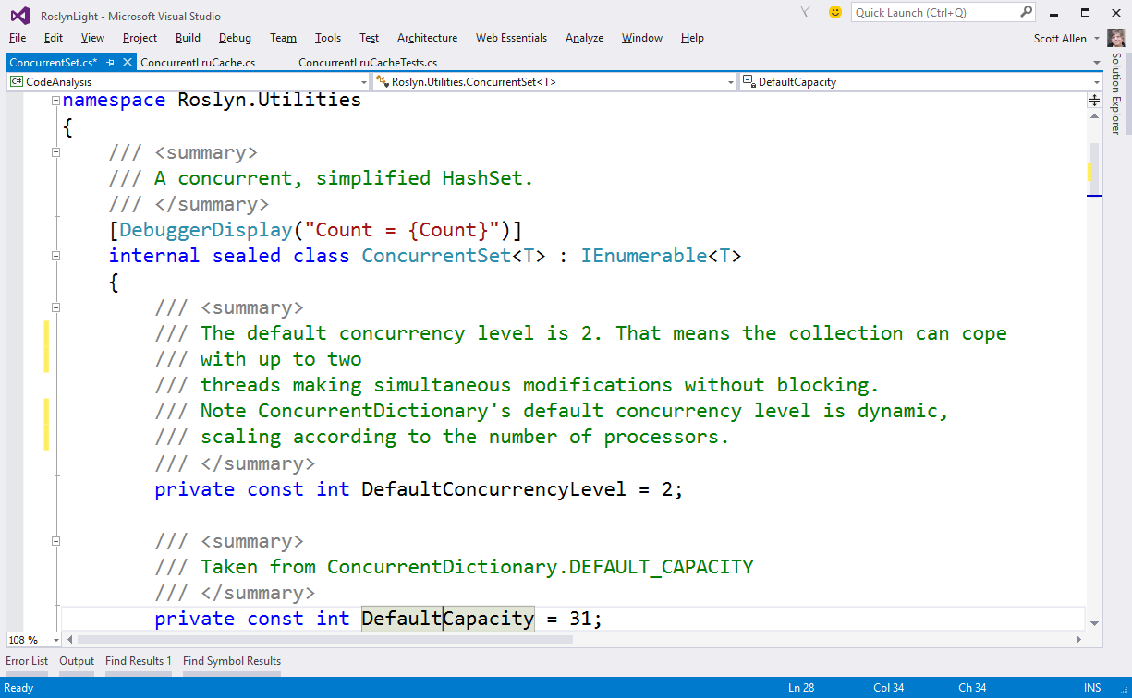
ConcurrentSet

Slide 37
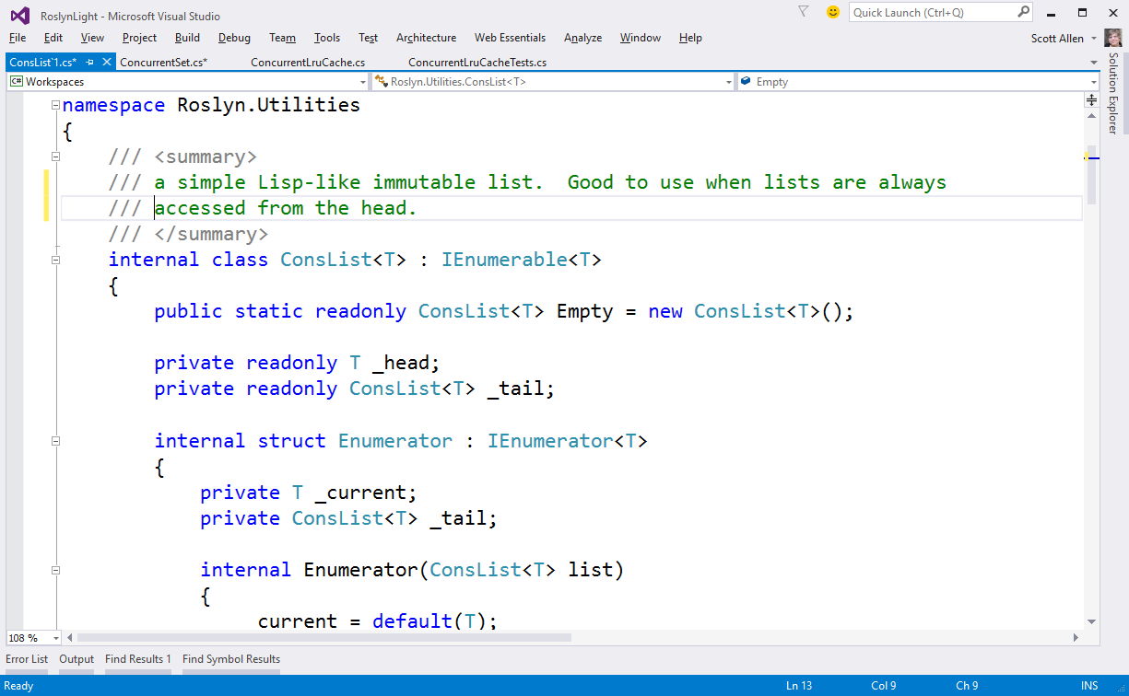
ConsList

Slide 38
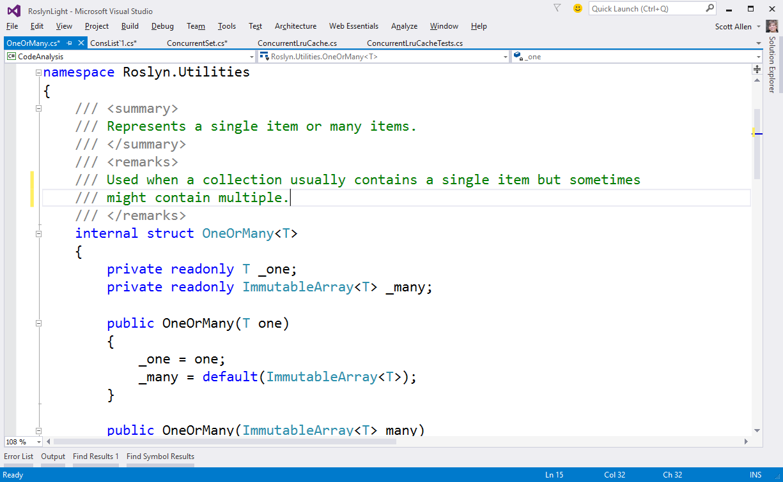
OneOrMany

Slide 39
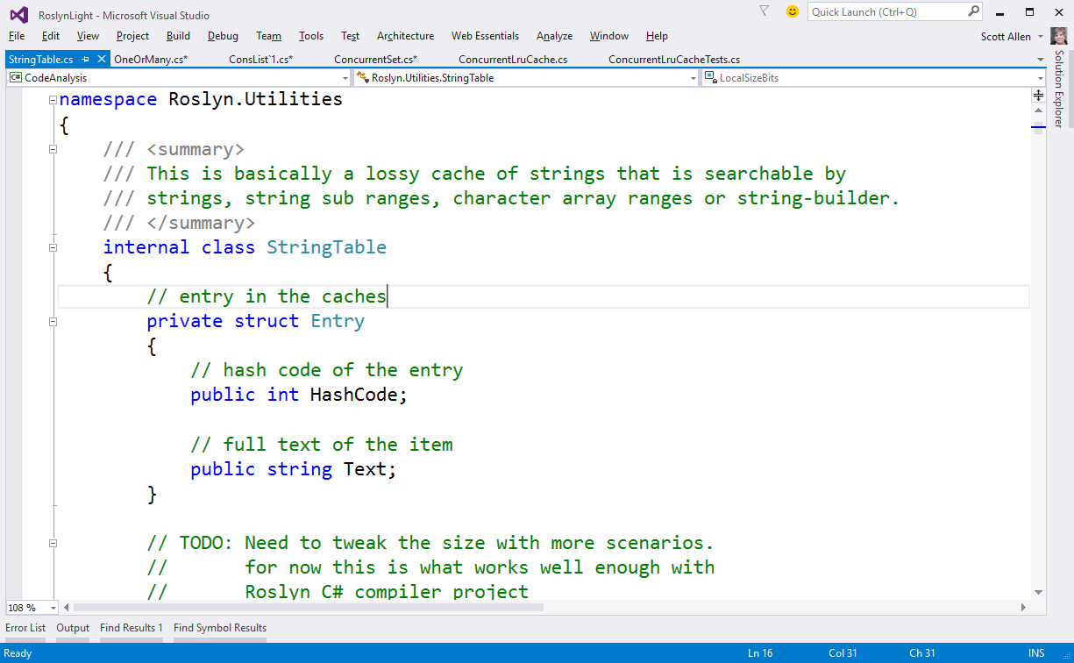
String Table

Slide 40
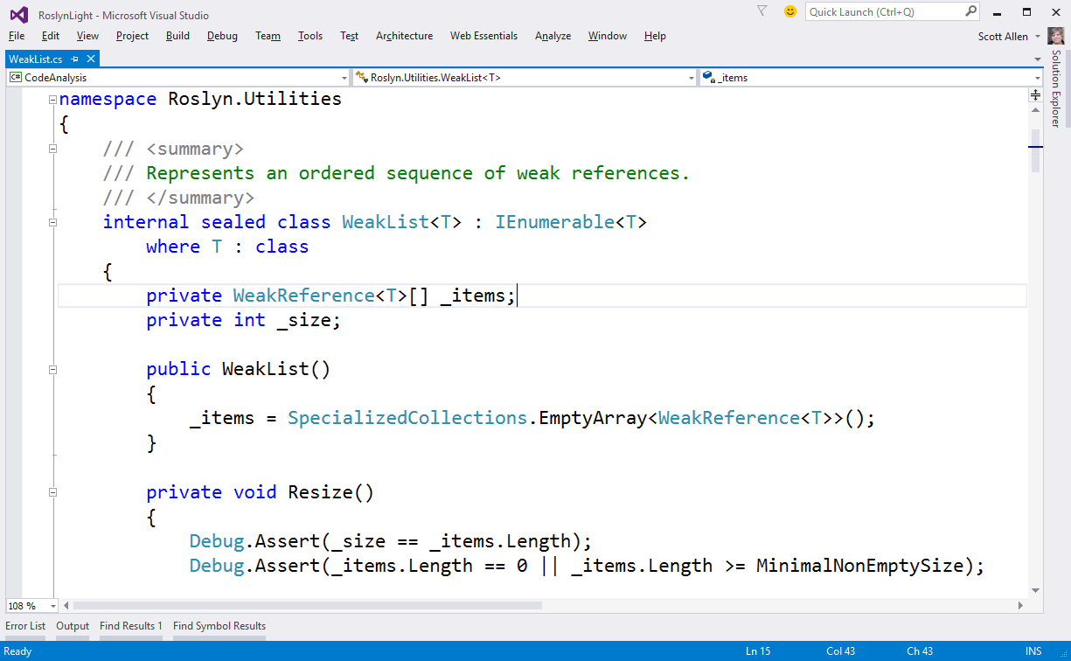
WeakList

Slide 41
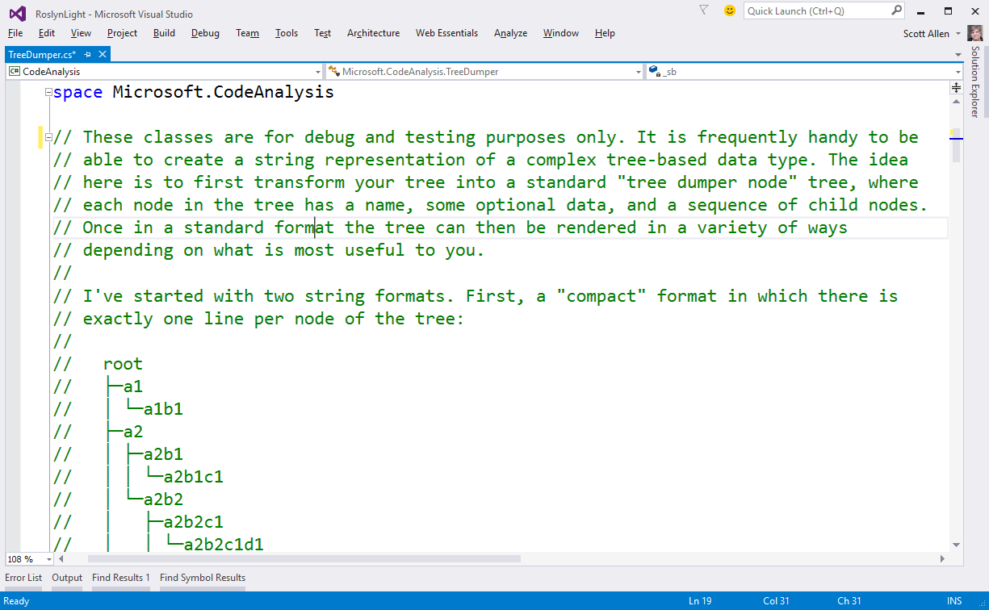
TreeDumper

Slide 42
Interesting?

Slide 43
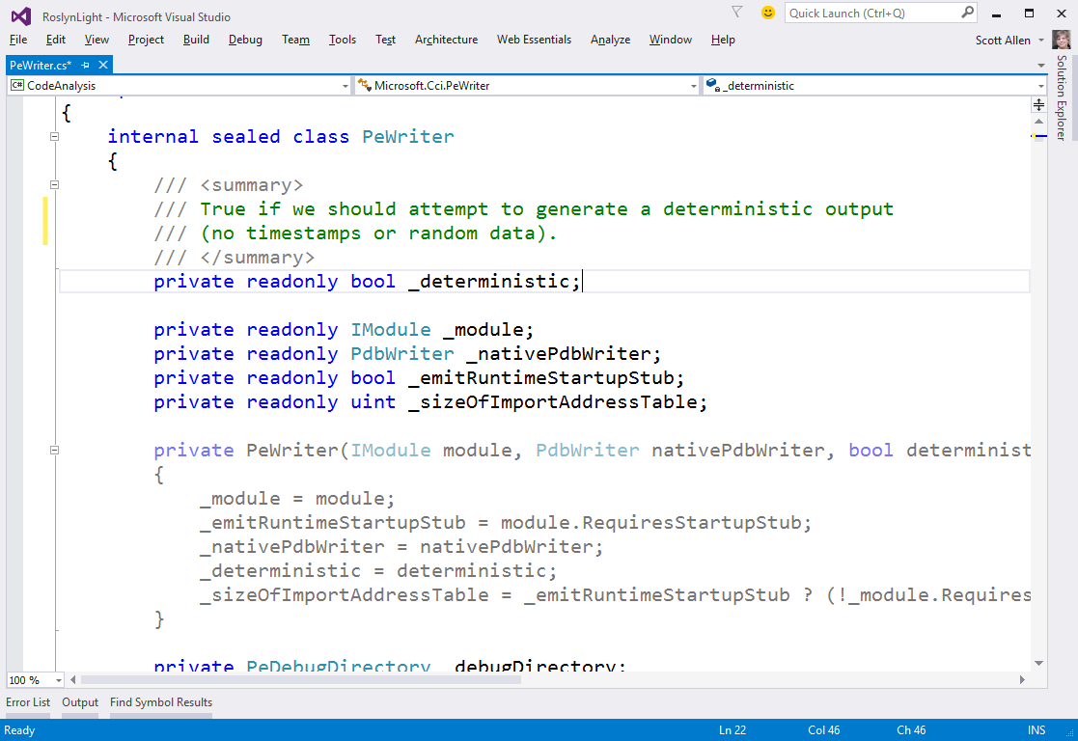
PeWriter

Slide 44
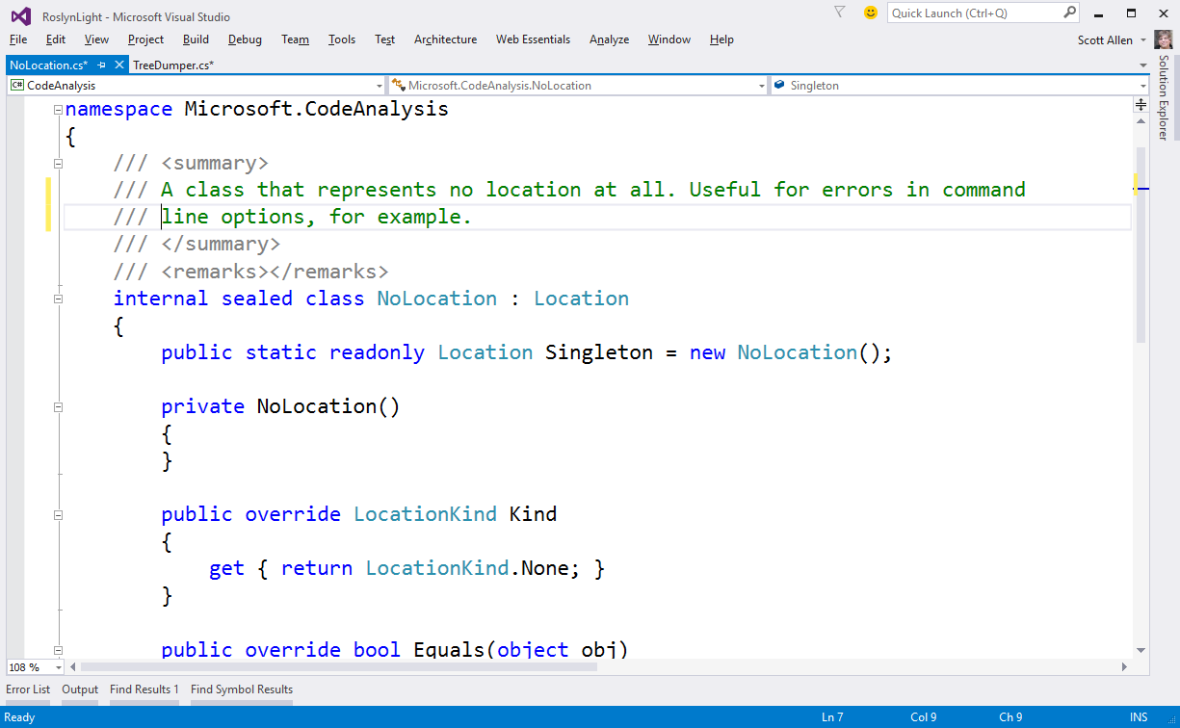
NoLocation

Slide 45
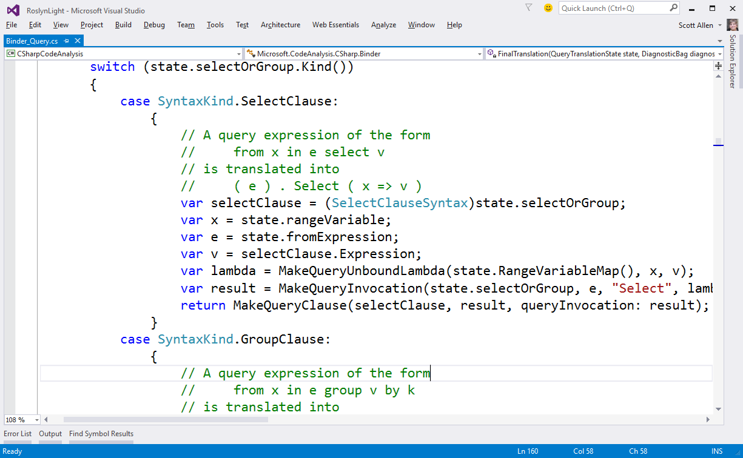
BinderQuery

Slide 46
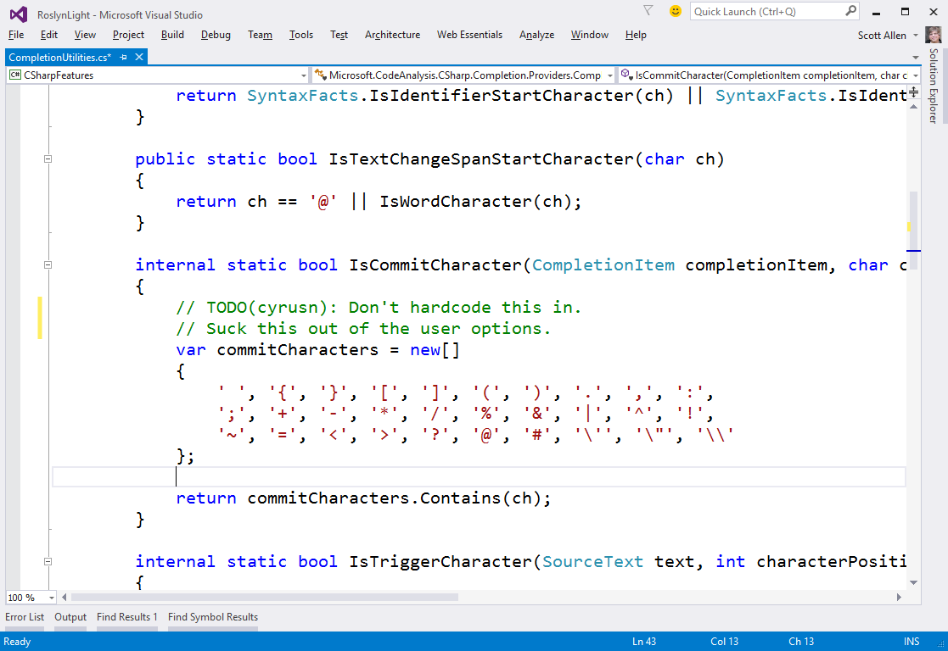
CompletionUtilities

Slide 47
Generics

Slide 48
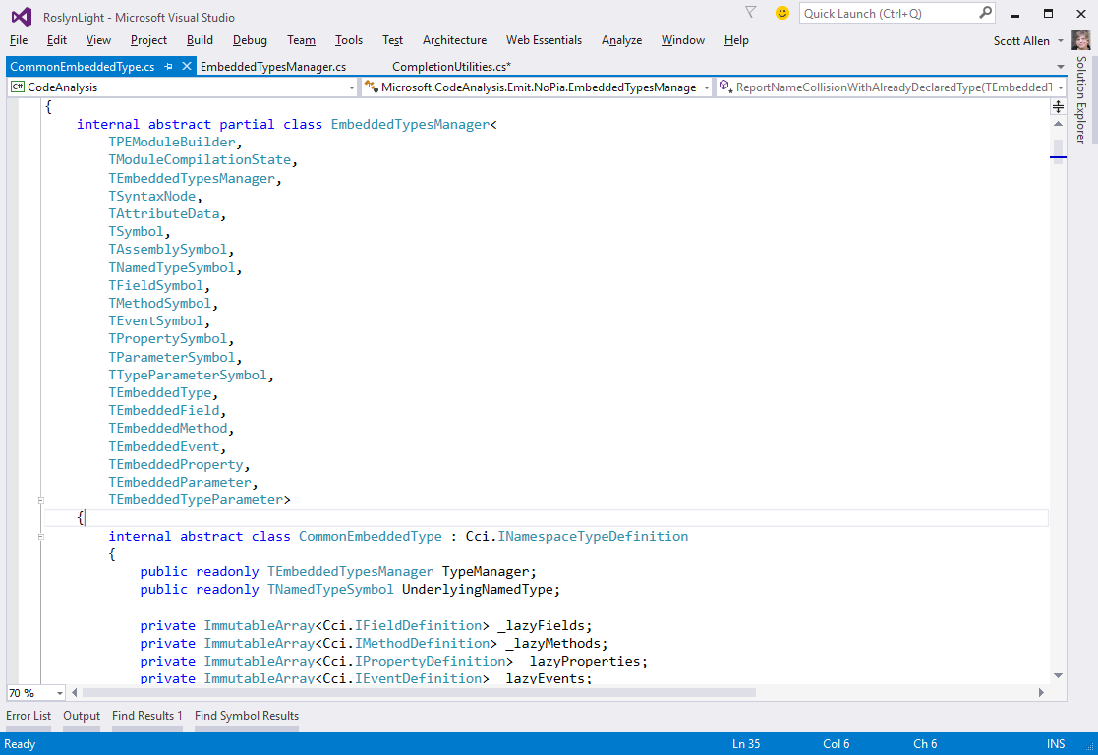
EmbeddedTypesManager

Slide 49
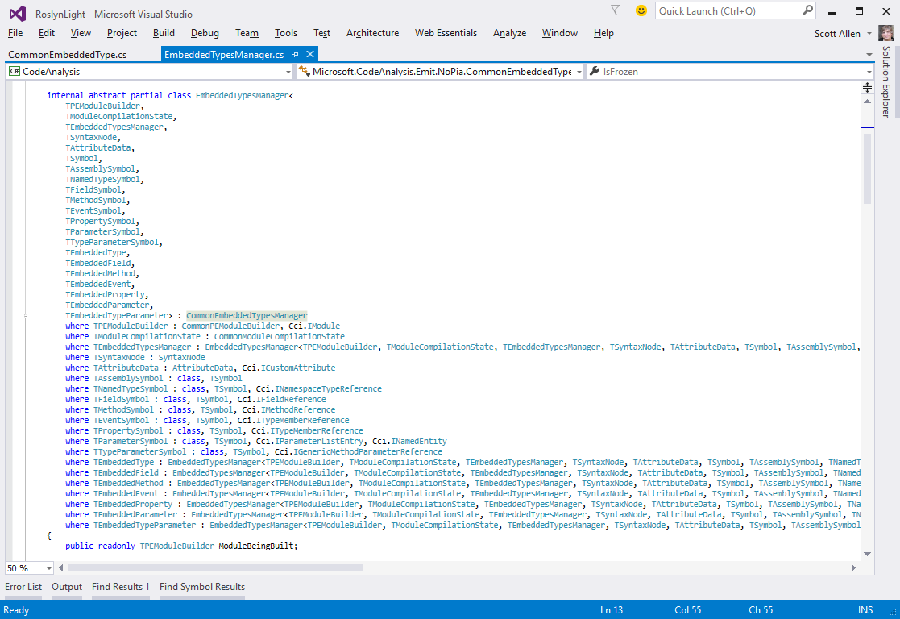
EmbeddedTypesManager

Slide 50
Patterns

Slide 51
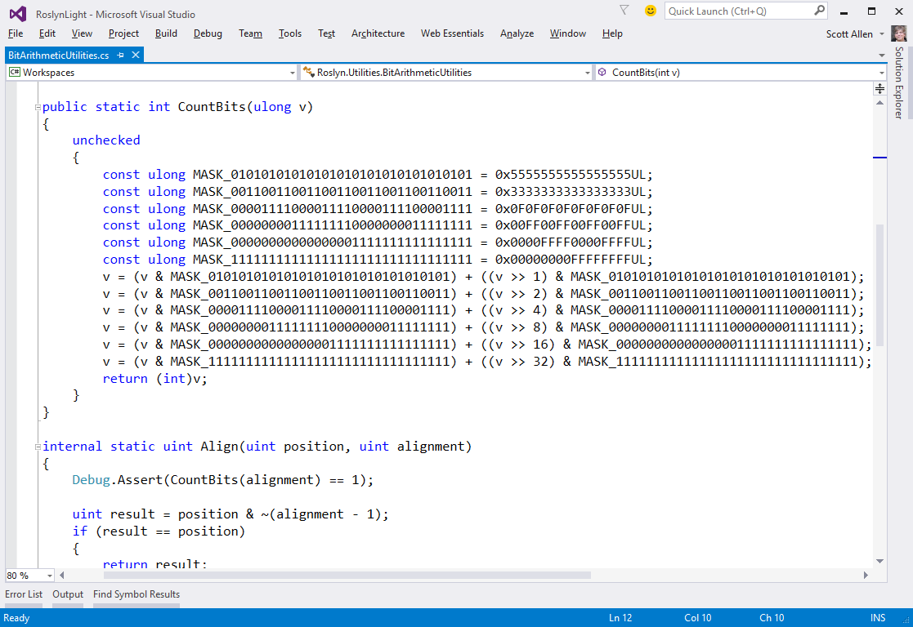
BitCounter

Slide 52
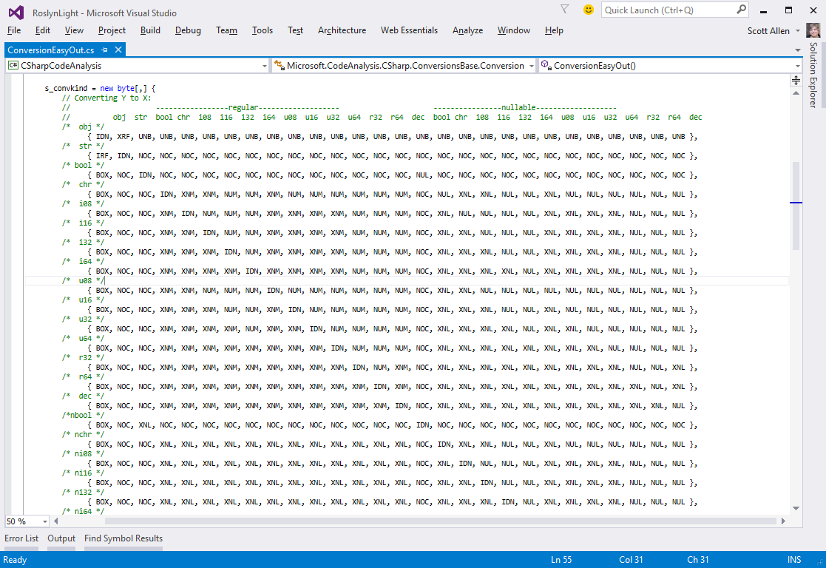
ConversionEasyOut

Slide 53
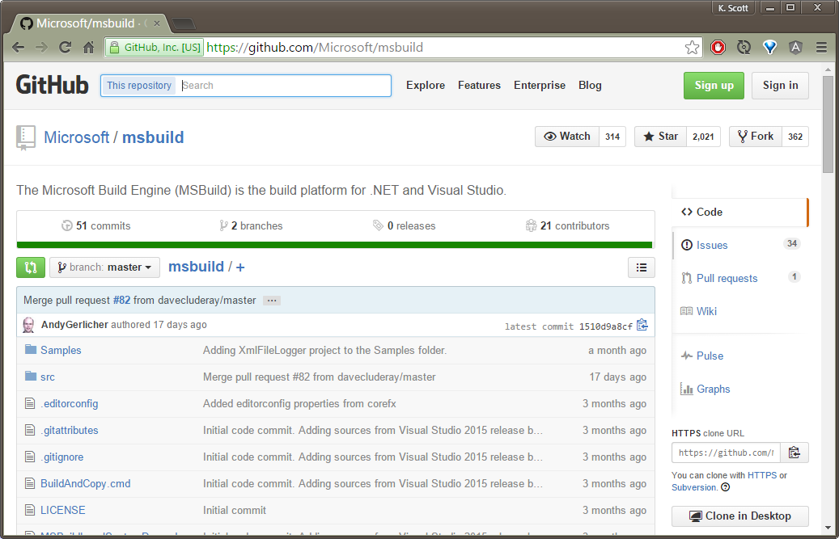
MSBuild

Slide 54
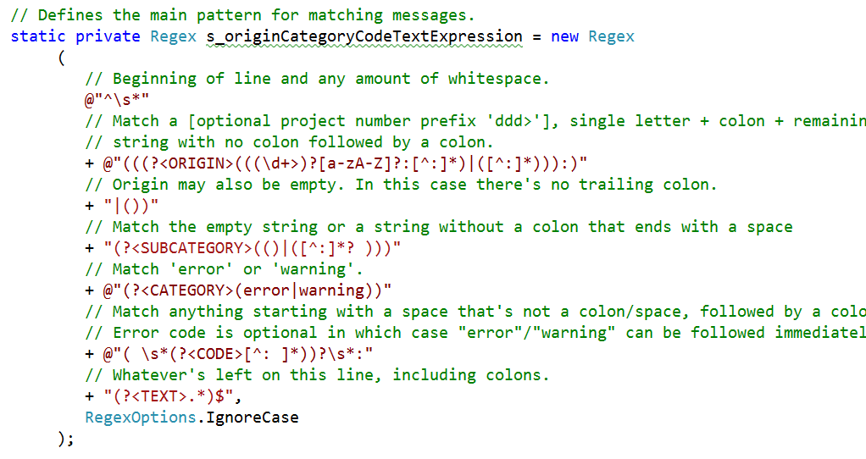
CanonicalError

Slide 55
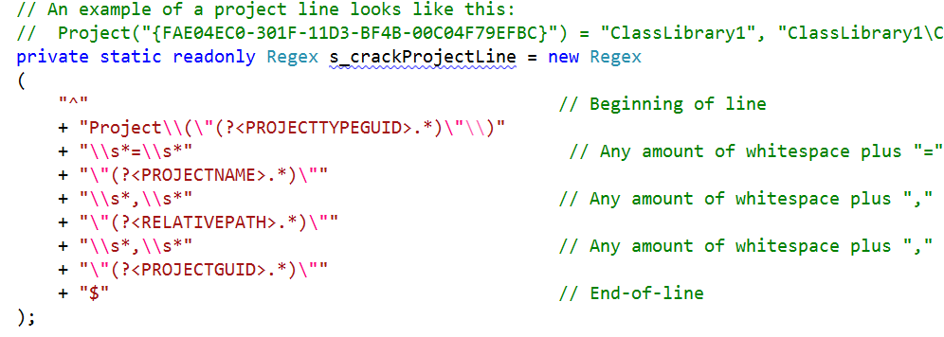
SolutionFile

Slide 56
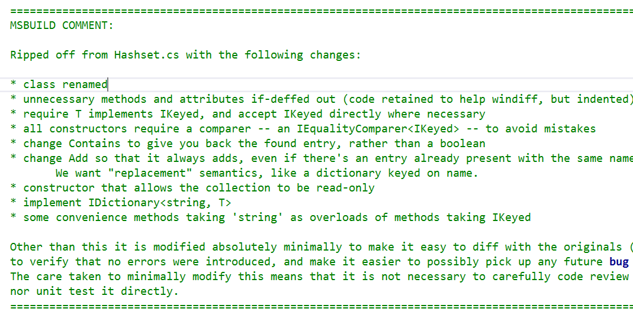
HashSet

Slide 57
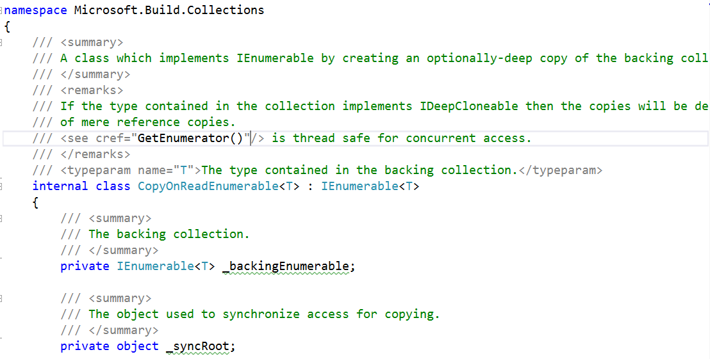
CopyOnReadEnumerable

Slide 58
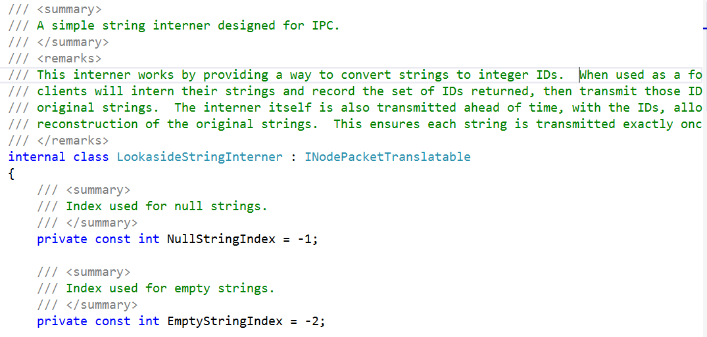
LookasideStringInterner

Slide 59

OpportunisticIntern

Slide 60

ReusableStringBuilder

Slide 61

StringBuilderCache

Slide 62

GetFrameworkPath

Slide 63

ErrorUtilities

Slide 64

InternalErrorException

Slide 65

EscapingUtilities

Slide 66
Tests

Slide 67

Compiling Code

Slide 68

Emit Tests

Slide 69

Testing PDB Output

Slide 70

Breaking Changes

Slide 71

Breaking Changes

Slide 72

Options Tests

Slide 73

Compile and Verify

Slide 74

ColorColor Tests

Slide 75

Fuzz Testing

Slide 76

Switch Tests

Slide 77

Test Everything

Slide 78

TODOs

Slide 79
Summary
Thanks for listening!
scott@OdeToCode.com

